Slide 1

This is Rotary
Notes:
This is a program that we hope is helpful for all Rotarians and their partners.
It is a very quick overview of what Rotary is all about.
There are so many programs of Rotary International and The Rotary Foundation, and here in our District – hopefully this will answer some of your questions and/or make you want to learn more.

Slide 2

What it is to be a Rotarian
To be young is to swim in a pool you did not dig –
To be a Rotarian is to dig a pool you may never swim.
To be young is to dance to music you did not write –
To be a Rotarian is to write music you may never dance.
To be young is to sit under trees you did not plant –
To be a Rotarian is to plant trees you may never sit.
To be young is to seek benefits from a city you did not build-
To be a Rotarian is to build a city and community from which you may never benefit.

Slide 3


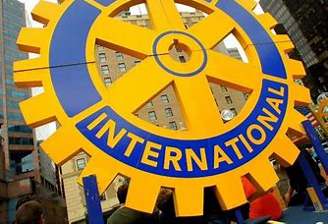



What Is Rotary? People Of Action
Notes:
To answer the question what is Rotary… We are the largest most financially sound membership organization whose logo is recognized in more countries than any other in the world. Every minute of every day we feed, we house, we vaccinate, educate, advocate, comfort and provide services. This is Rotary!

Slide 4
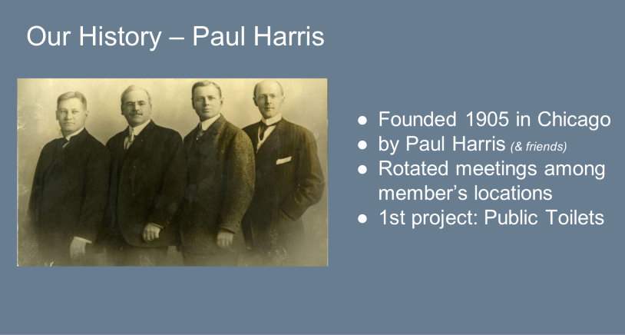

Slide 5
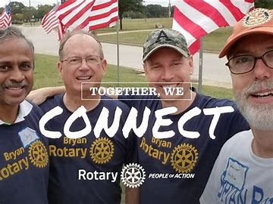
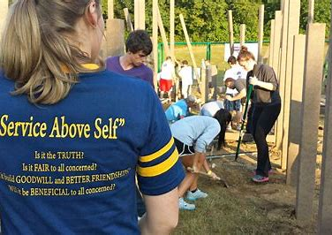
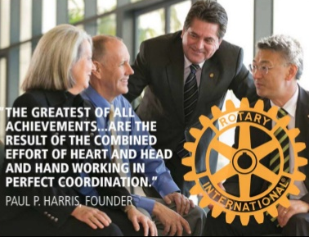

What is Rotary?
1.2 million Rotarians – 35,000 Clubs – 200 Countries
“Service Above Self”
Notes:
Rotary is a membership organization that does service. We are a global network of business and professional leaders. We do humanitarian service projects and encourage high ethical standards. We strive for goodwill and peace in the world. There are 1.2 million of us in 35,000 clubs in over 200 countries around the world. Our motto is Service Above Self.

Slide 6
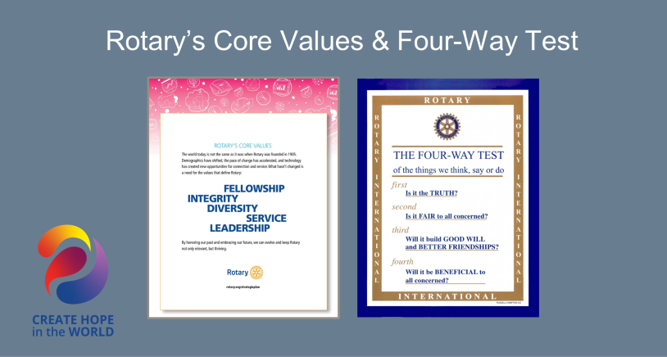

Slide 7

$200 Million and 16 Million
Volunteer Hours
Rotarians invest more than $200 million and 16 million volunteer hours every year.
Notes:
Rotarians are people of action because we are guided by a strong vision. Together, we see a world where people unite and take action to create lasting change – across the globe, in our communities, and in ourselves. Each year, Rotarians invest more than $200 million and 16 million volunteer hours to promote peace, fight disease, provide clean water, save mothers and children, support education and grow local economies.

Slide 8
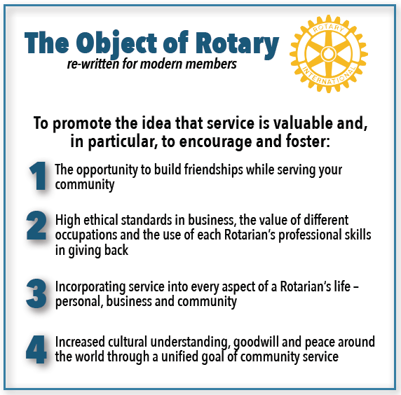
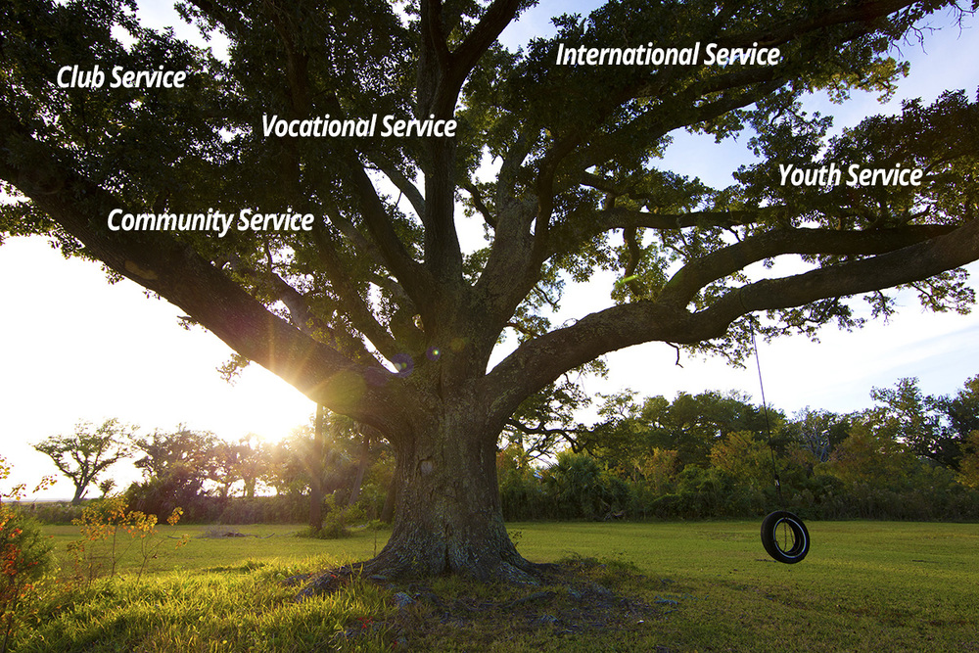
We implement the Object of Rotary through Five Avenues of Service
Notes:
The Object of Rotary is four principles developed over the years to provide Rotarians with a strong, common purpose and direction. They serve as a foundation for our relationships with each other and the action we take in the world. The Object of Rotary comes to life through Five Avenues of Service which are the branches of a deeply rooted membership organization, and they are: Club Service, Vocational Service, Community Service, International Service and Youth Service. This is how we reach out and make a difference in people’s lives around the world and right here at home.

Slide 9

Rotary Mottos
“Service Above Self”
“One Profits Most Who Serves Best”

Slide 10
The Organization of Rotary
Grassroots organization
All of the work is done by local Rotarians in local clubs!
District and Rotary International
support clubs
Notes:
All of the work of Rotary is done by local Rotarians in Local clubs.
The District and RI are here to support your club and help you continue to do the great work you do, locally and around the world!

Slide 11
Rotary’s World and our Rotary Family
34 Zones
530 Districts
47,779 Clubs
1,383,187 Members
Notes:
This is our Rotary world and family.
About 1.4 million Rotarians & Rotaractors in 47,779 clubs… We are a very large organization, but we do our work in clubs just like this one.

Slide 12
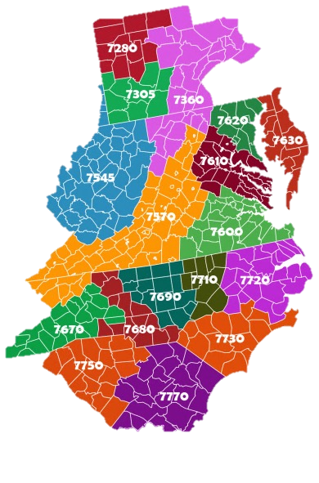

Rotary International Zone 33
Notes:
Rotary International's Board of Directors is elected by Rotary's 34 zones.
RI bylaws require the composition of the zones to be reviewed at least every eight years to ensure that each zone has approximately the same number of Rotarians.
Zone 33, to which we belong, includes these states in the Southeastern US. We work together with Zone 34, which includes Georgia, Florida and the Caribbean under the leadership of a Zone Director, who is Jeremy of the Rotary Club of Grand Cayman…

Slide 13


District 7630
District Support Includes:
District Governor
Assistant Governors
Committees
Notes:
Rotary districts exist for one reason ; to help your club and all others to excel. We are all members of District 7630…
Districts connect clubs with each other through Assistant Governors and committees, and we share resources from Rotary International.
The District trains club leaders so that Rotarians get the most from their membership and shine as leaders in their communities…
Pre-PETS, President-Elect Training Seminars (PETS) train Presidents-elect, Secretaries, Treasurers and Board members.
We also include our Annual District Assembly as a gathering that unites leaders from the District under the direction of the incoming District Governor to maximize our effectiveness..
Rotary Leadership Institute – RLI - is an indiependentl program for Rotarians with substantial support from several Rotary leaders… RLI strongly believes that a good Rotary Club leader must know the evolution of Rotary, its current status and activities in the world and have a vision for what Rotary can be in the future.

Slide 14
ROTARY DISTRICT 7630 ORGANIZATION CHART
ROTARY CLUBS
ROTARY INTERNATIONAL
DISTRICT 7630
Notes:
Remember, and I can’t say this enough, all these activities and our organization structure exist to help you and your club be even greater than it is today…

Slide 15
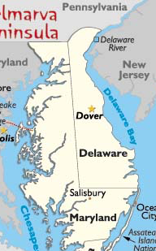
District 7630
37 Clubs
1419
Active
Rotarians
Notes:
Our district has 39 clubs… We’re 125 miles long by 55 miles wide at its widest point…

Slide 16

Clubs
We are members of a Rotary Club
Belong to Rotary International
RI constitution and bylaws
Notes:
We are all members of our Rotary clubs. And those clubs belong to District 7630 that are in Zone 33 of Rotary International.
We follow and abide by the recommended Rotary International constitution and bylaws.
We set our own policies as long as they do not conflict with either the RI recommended constitution and bylaws.

Slide 17
Attendance
No Specific Attendance Requirements
Welcome to Attend Any Rotary Club In
The World
Notes:
If you miss a club meeting, you are encouraged to expand your Rotary horizon by attending a make up meeting at any Rotary club in your neighbourhood or somewhere in the world – a practice that guarantees all Rotarians a warm welcome in communities around the globe.
Find meeting places and times in the Official Directory at www.rotary.org
Or try an online meeting at one of the E-clubs.
You can also make up meetings by participating in a club service project, attending a club board meeting or a qualified make up which is approved by your club.
Makeups are valid for 14 days before and after the meeting you have missed.

Slide 18


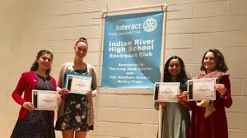
Rotary International Programs
Interact - 12 – 18 years
Rotaract – Age 18 & Over
Notes:
Rotary clubs organize and sponsor this service organization called Interact for youth ages 12 to 18. The term Interact is derived from international and act from action. Each club must plan annual projects of service to its school, its community and the world. Interactors develop leadership skills while discovering the power of Service Above Self.
Rotaract clubs bring together people ages 18 and older to exchange ideas with leaders in the community, develop leadership and professional skills, and have fun through service.
In communities worldwide, Rotary and Rotaract members work side by side to take action through service. From big cities to rural villages, Rotaract is changing communities like yours.

Slide 19


Rotary International Programs
Rotary Youth Leadership Awards (RYLA)
Rotary Youth Exchange – Long & Short
Notes:
Each year, thousands of young leaders are selected to attend Rotary sponsored leadership program; RYLA. Groups of outstanding young people ages 14 to 18 spend several days in a challenging program of leadership training and social activities. Our District sponsors over 100 young people on each President’s Day weekend at our RYLA meeting on Ocean City.
Rotary Youth Exchange builds peace one young person at a time. Students learn a new language, discover another culture, and truly become global citizens. Exchanges for students ages 15-19 are sponsored by Rotary clubs in more than 100 countries. Long term students spend a year abroad and Short term exchanges usually last about 3 months.
New Generations Service Exchange is a short-term, customizable program for university students and professionals up to age 30. Participants can design exchanges that combine their professional goals with a humanitarian project.

Slide 20
Rotary International Programs
Rotary Fellowships
Rotarian Action Groups (RAG’s)
Notes:
Friendship Exchange is an international exchange program for Rotary members and friends that allows participants to take turns hosting one another in their homes and clubs. Participants may travel as individuals, couples, families, or groups, and may be Rotary members or not. This exchange is funded by the participating individuals.
Rotarian Action Groups are independent, Rotary-affiliated groups made up of people from around the world who are experts in a particular field, such as economic development, peace, addiction prevention, the environment, or water. Action groups offer their technical expertise and support to help clubs plan and implement projects to increase our impact
An intercountry committee offers you the chance to work with Rotary clubs or districts in two or more countries. You might work with a committee to carry out international service projects, to sponsor a new Rotary club, or to develop a twin club relationship. Close to 250 ICCs in Europe, Africa, Asia, North and South America are country based activities for direct bilateral humanitarian and peace efforts

Slide 21

Rotary Fellowships are international groups that share a common passion. Being part of a fellowship is a fun way to make friends around the world, explore a hobby or profession, and enhance the Rotary experience.

Slide 22

Explore our Fellowships
Interested in a particular subject? Visit the group's website or email it to learn more.
Amateur Radio
Chess
Educators
Fishing
Flying
Golf
Hiking
Photographers
Railroads
Recreational Vehicles
Rotary on Stamps
Rowing
Scouting

Slide 23
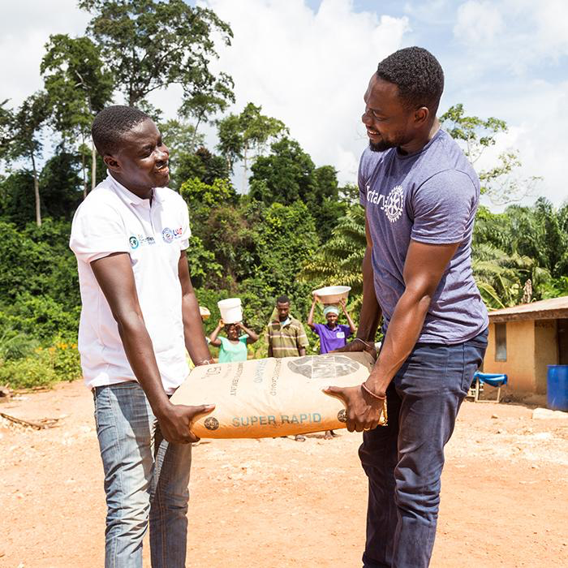
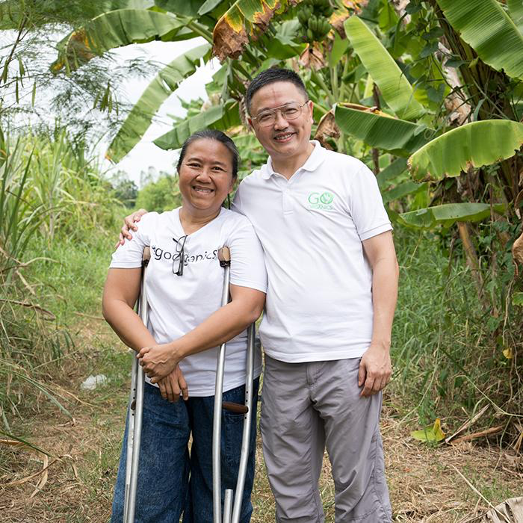
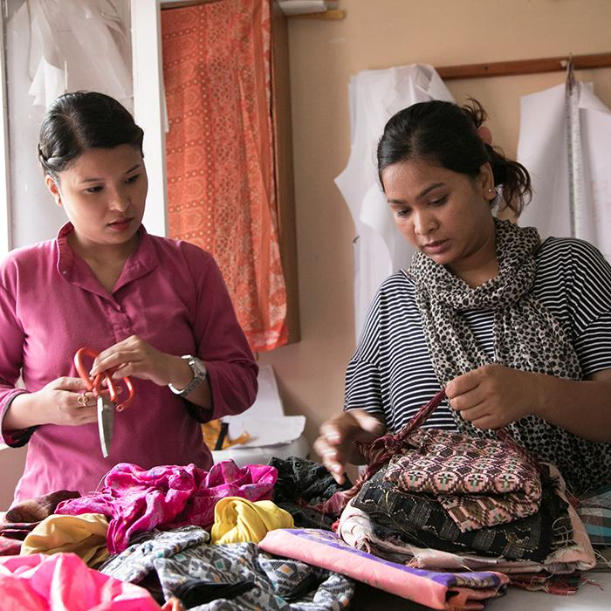
Rotary's Commitment to Diversity, Equity, and Inclusion
DIVERSITY
EQUITY
INCLUSION
Rotary welcomes people of all backgrounds, cultures, experiences, and identities.
Rotary strives for the fair treatment, opportunity, and advancement of all Rotary participants.
Rotary is working to create experiences where all people feel welcomed, respected, and valued.
Notes:
At Rotary, we understand that cultivating a diverse, equitable, and inclusive culture is essential to realizing our vision of a world where people unite and take action to create lasting change... We value Diversity in all ways... we commit to advancing equity in all aspects of Rotary, and we strive to create an inclusive culture where each person knows they are valued and belong…

Slide 24

The Rotary Foundation (TRF)
Notes:
The Rotary Foundation of Rotary International is a not-for-profit corporation.
15 Rotarian trustees manage the business of the Rotary Foundation led by the trustee chair who is appointed by the RI President with agreement from the Board.
These funds supported humanitarian and educational programs implemented by clubs and districts. Also, global polio eradication activities.

Slide 25
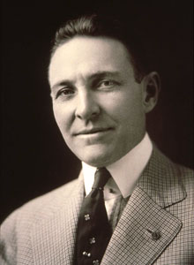
The Rotary Foundation
In 1917, an endowment was set up “for the purpose of doing good in the world”.
Arch Klumph
Notes:
Some magnificent projects grow from very small seeds. TRF had that sort of modest beginning.
In 1917, RI President Arch Klump told the delegates to the Atlanta convention that “it seems eminently proper that we should accept endowments for the purpose of doing good in the world.” The response was polite and favourable, but the fund was slow to materialize. A year later, the Rotary Endowment Fund, as it was originally labelled, received its first contribution of US $26.50.
After six years the endowment reached only $700.00. A decade later TRF was formally established at the 1928 Minneapolis convention. In the next four years TRF grew to $50,000 and then in 1937 a $2 million goal was announced. But these plans were abandoned with the outbreak of World War II.
In 1947, upon the death of Paul Harris a new era opened for TRF as memorial gifts paired in to honour the founder of Rotary.
Since then TRF has been achieving its noble objective of furthering understanding and friendly relations between peoples of different nations.

Slide 26


Slide 27
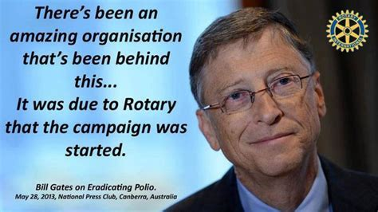

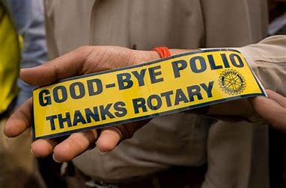
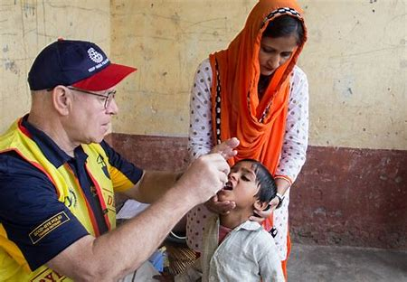
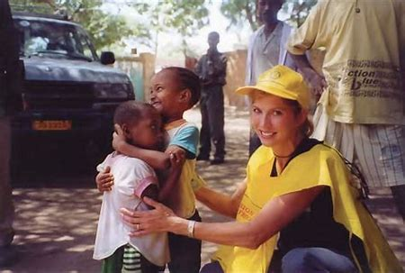
99.9% Reduction Of Cases Worldwide
Notes:
The Rotary Foundation is best known for its work to end polio in the world. Polio Plus was launched in 1985 and has reached a 99.9% reduction in the number of Polio cases world-wide. The Bill & Melinda Gates Foundation joined Rotary in 2017 to commit $450 million to end polio.

Slide 28
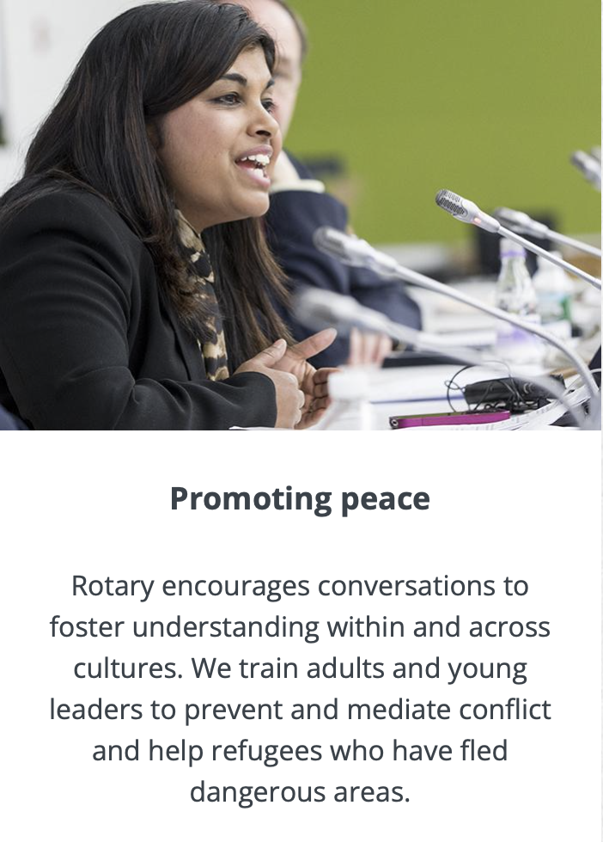
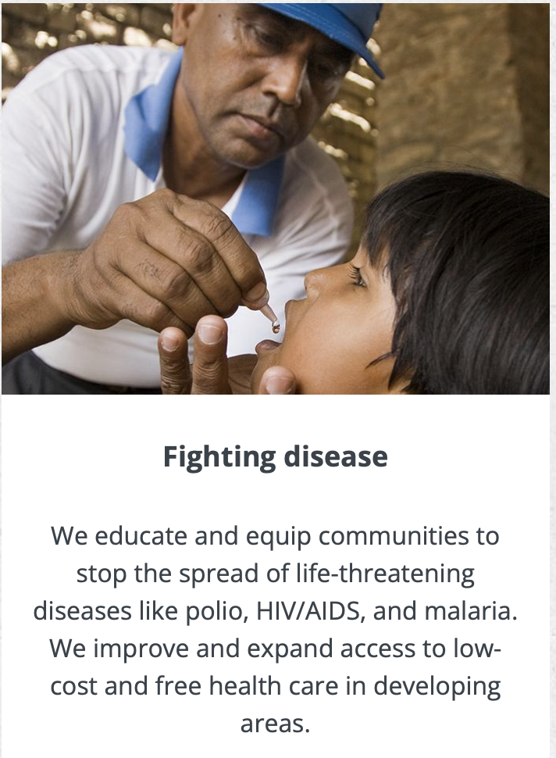
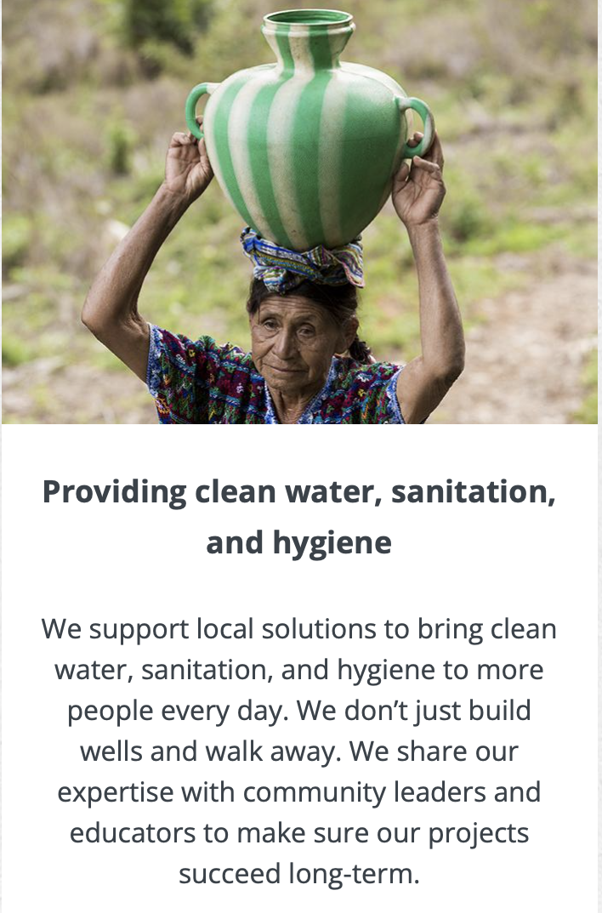
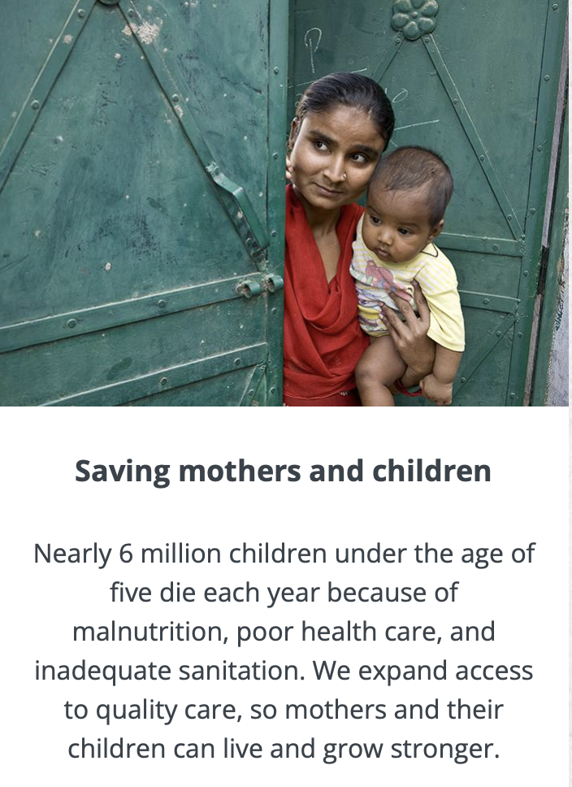
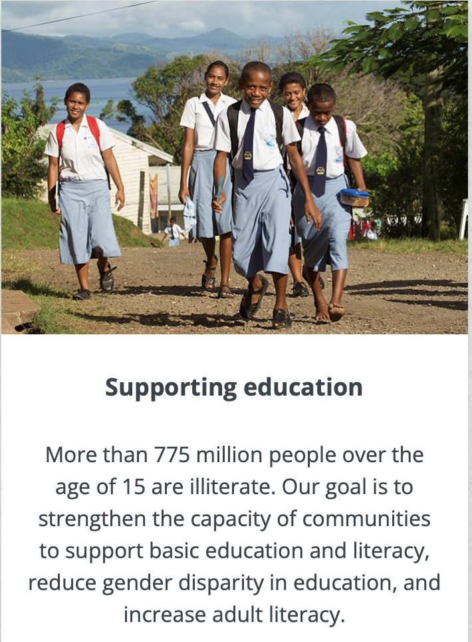
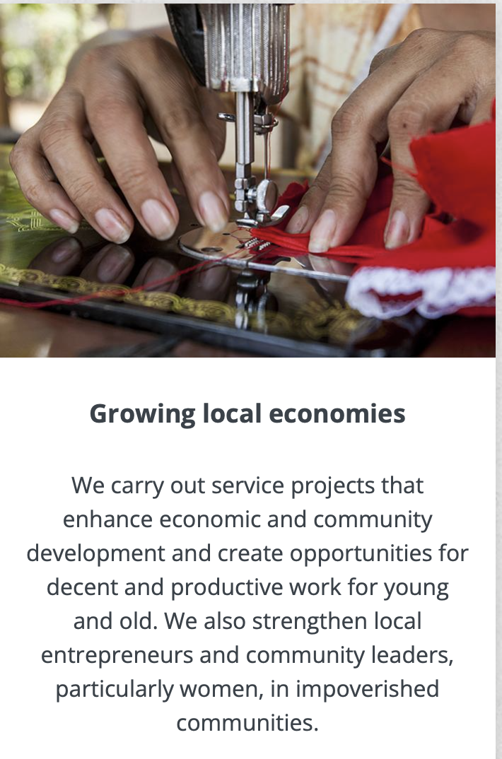

Rotary’s Causes
Notes:
Worldwide, Rotary focuses on 7 main causes:
Fighting Disease: Rotarians combat diseases like malaria, HIV/AIDS, Alzheimer’s, multiple sclerosis, diabetes, and polio. Prevention is important, which is why we also focus on health education and bringing people routine hearing, vision, and dental care.
Growing Local Economies: Our members and our foundation work to strengthen local entrepreneurs and community leaders, particularly women, in impoverished communities. We provide training and access to well-paying jobs and financial management institutions.
Promoting Peace: By carrying out service projects and supporting peace fellowships and scholarships, our members take action to address the underlying causes of conflict, including poverty, discrimination, ethnic tension, lack of access to education, and unequal distribution of resources.
Providing Clean Water: When people have access to clean water and sanitation, waterborne diseases decrease, children stay healthier and attend school more regularly, and mothers can spend less time carrying water and more time helping their families.
Saving Mothers & Children: We expand access to quality care, so mothers and children everywhere can have the same opportunities for a healthy future. An estimated 5.9 million children under the age of five die each year because of malnutrition, inadequate health care, and poor sanitation — all of which can be prevented.
Supporting Education: Our goal is to strengthen the capacity of communities to support basic education and literacy, reduce gender disparity in education, and increase adult literacy. We support education for all children and literacy for children and adults.
Protecting The Environment: Rotary members are tackling environmental issues the way they always do: coming up with projects, using their connections to change policy and planning for the future.

Slide 29
Or, Create Your Own Club
Satellite Club –
Hope to be Own Club
Companion Club –
Never Intend to be Own
Club
Impact Club –
Service Club

Slide 30

Characteristics of These Clubs
All Have A Host Rotary Club
Members are Members of Host Club
Meet at Different Time
Only Need 8 Members
Only Need Chair Person & Secretary
Can Attend All Functions of Host Club
No Attendance Requirements

Slide 31

Learn More
rotary.org
rotary7630.org
Notes:
Well I sure hope you have learned a bit more about Rotary.
Do, go on to rotary.org or the district site to learn more or to answer questions you might have in the future.
Thank you

Slide 32

Questions???

