Slide 1
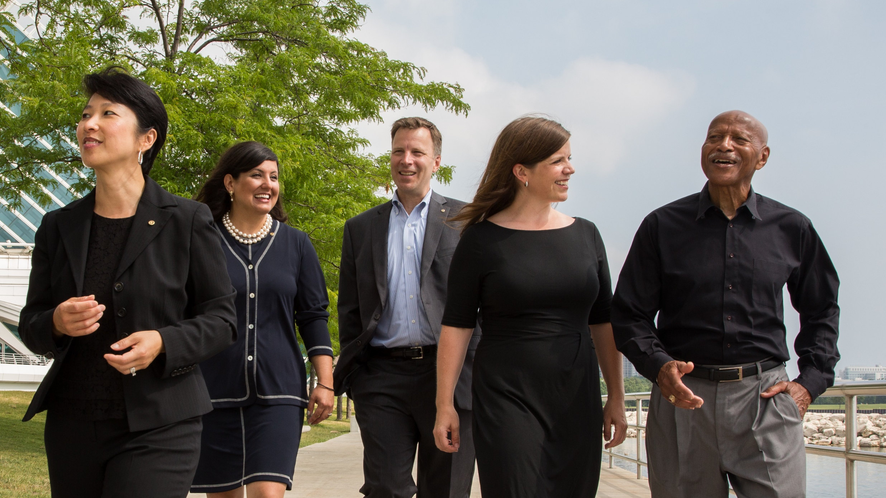
Rotary Fellowships
A Club beyond your own Club

Slide 2
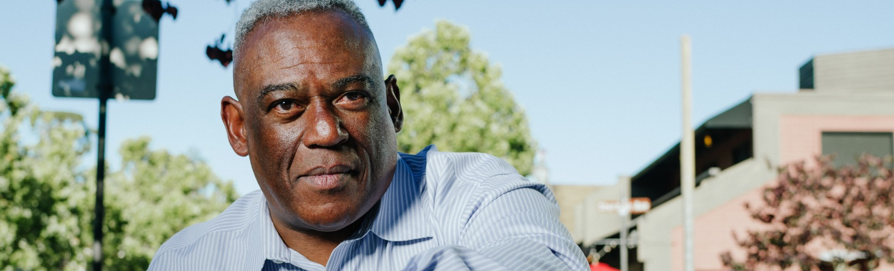
What are Rotary Fellowships?
Groups of Rotarians and future Rotarians who share interests in:
Recreational Activities
Hobbies
Sports
Vocations
Rotary History
Occupations
Special Interest
Notes:
Rotary Fellowships are international, independently organized groups of any interested individual who share a common hobby, recreational interest, or profession. Rotary Fellowships give their members the opportunity to have fun, make new friends around the world, and enhance their experience in Rotary.

Slide 3
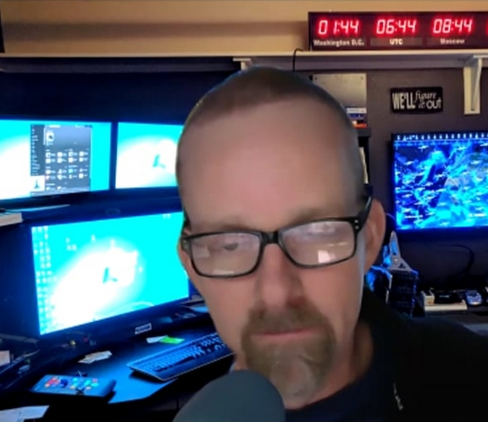
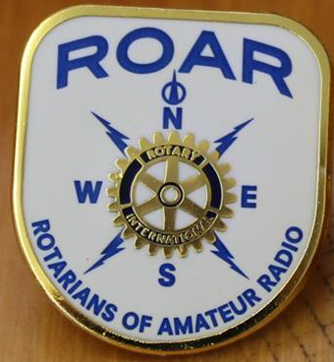

Rotarians of Amateur Radio
100’s of Members around the world
IFRoar.org

Slide 4
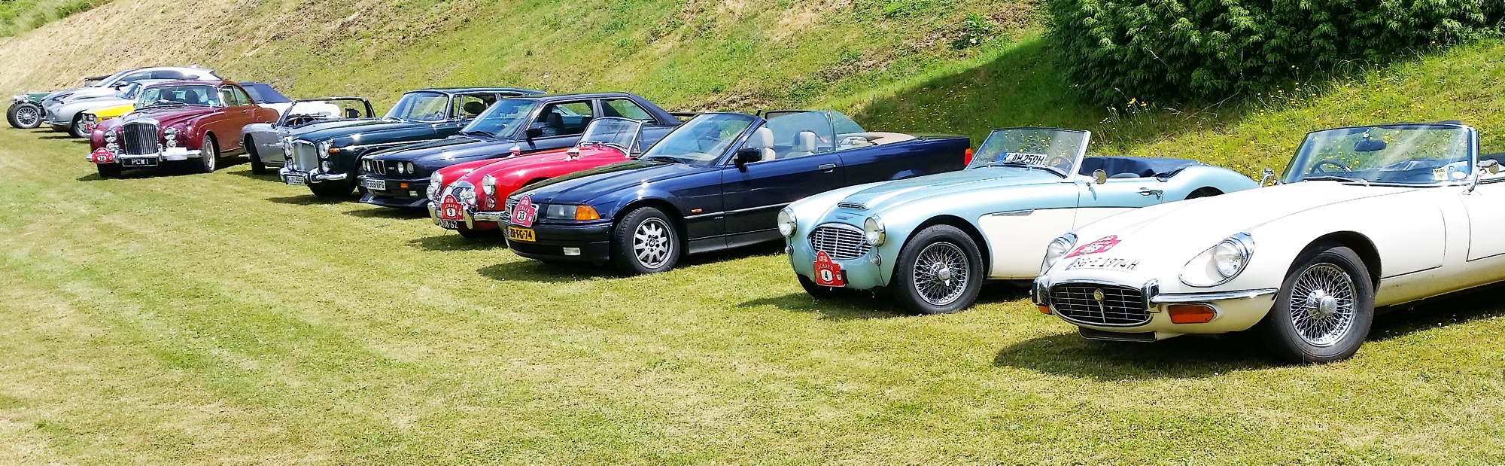
Antique, Classic and Historic Automobile world Fellowship of Rotarians
Preservation of classic and historic automobiles
Members around the world
ACHAFR.eu

Slide 5
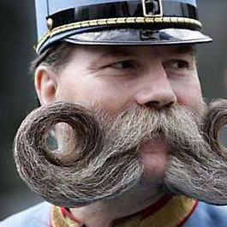
Beard and Moustache Appreciation Rotarian Fellowship
Rotarians who Appreciate Beards, and Moustaches
facebook.com/groups/257317251755086/

Slide 6
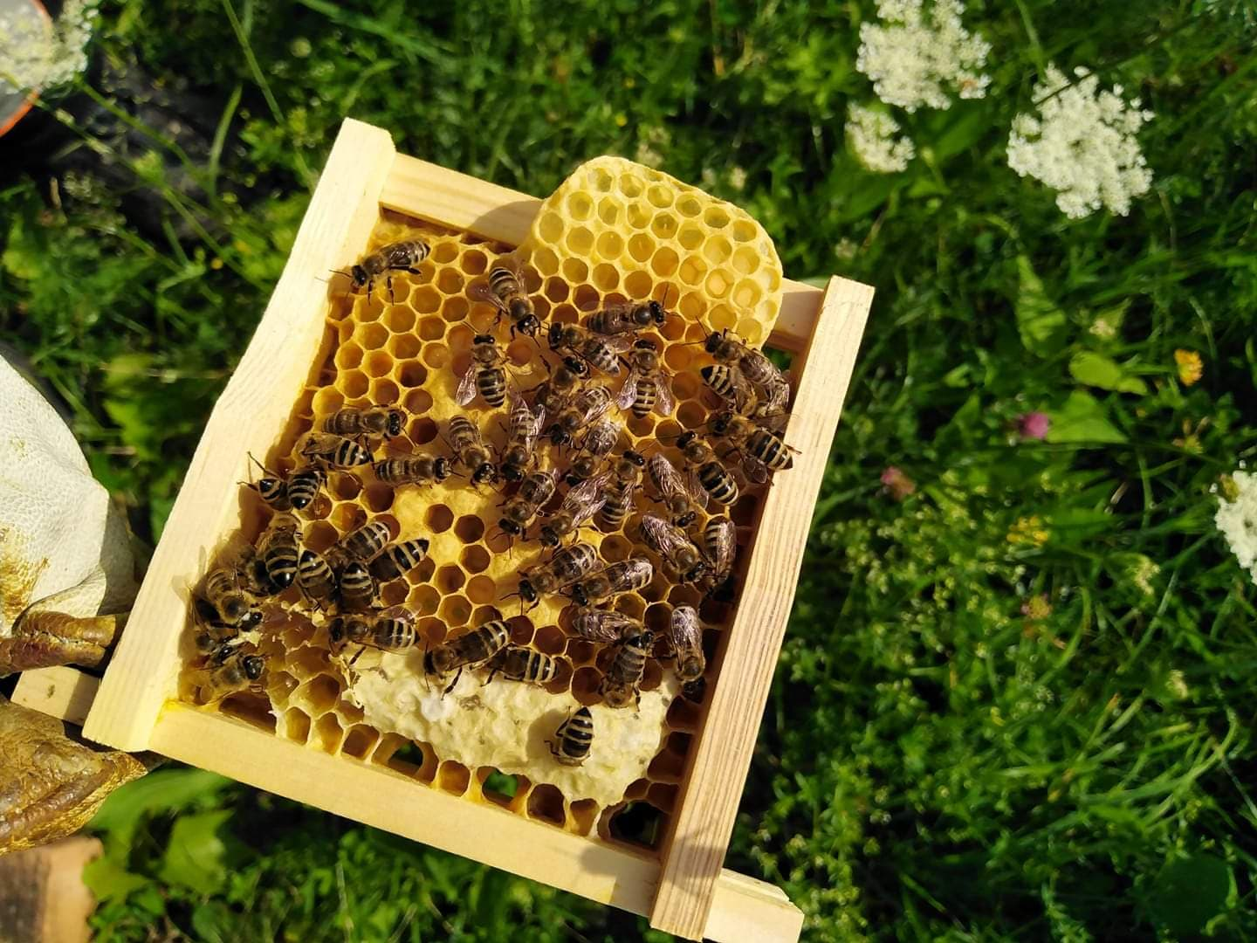
International Bee Rotary Fellowship
Rotarians that are interested in bees and bee-related activities
facebook.com/InternationalBeeRotaryFellowship/

Slide 7
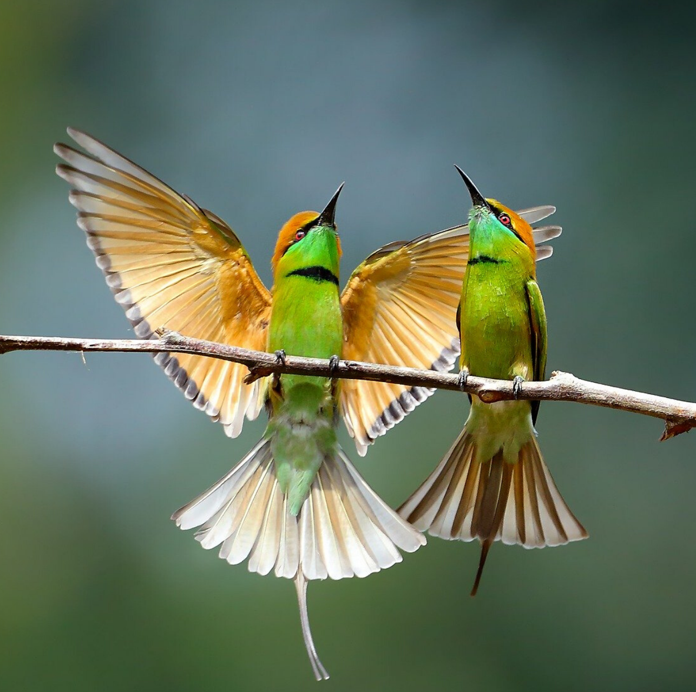
International Fellowship of Birdwatching Rotarians
Rotarians interested in birding
IFBR.nl

Slide 8

International Chess Fellowship of Rotarians
Chess with fellow Rotarians
www3.sympatico.ca/brian.clark/icfr/index.htm

Slide 9

Cruising Rotarians Fellowship
Rotarians who share a love of cruising
Hundreds of Members
facebook.com/groups/cruisingrotariansfellowship

Slide 10
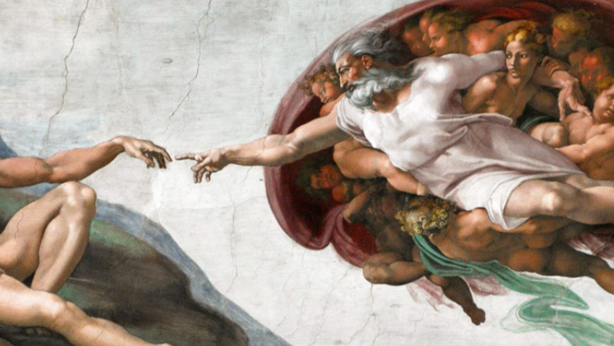
Fellowship of Rotarians who Appreciate Cultural Heritage
Preserving and promoting cultural heritage
Over 250 Members
FRACH.org

Slide 11
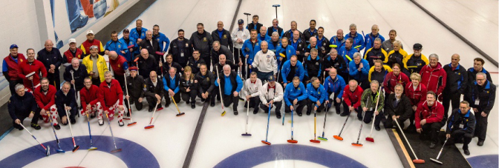
International Curling Fellowship of Rotarians
Rotarians who enjoy curling
Curling competition every two years
CurlingRotarians.com

Slide 12
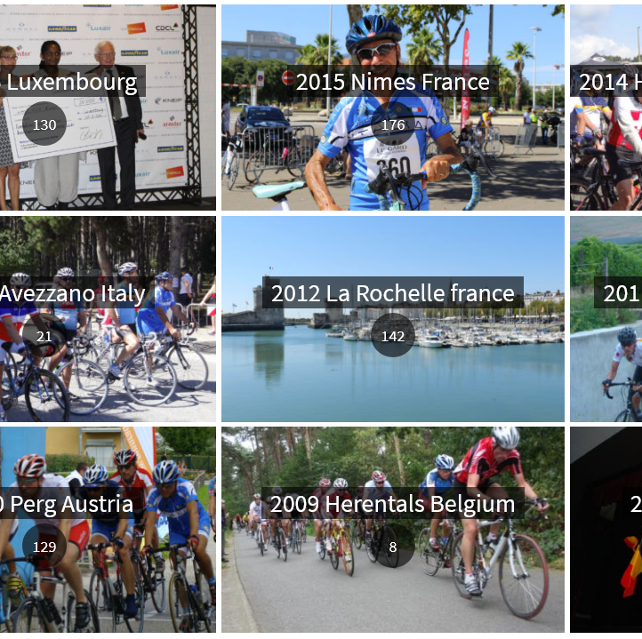
Rotary Fellowship Cycling to Serve
Rotarian and Rotaract who enjoy cycling
Annual Cycling to Serve World
4-days cycling event
CyclingToServe.org

Slide 13
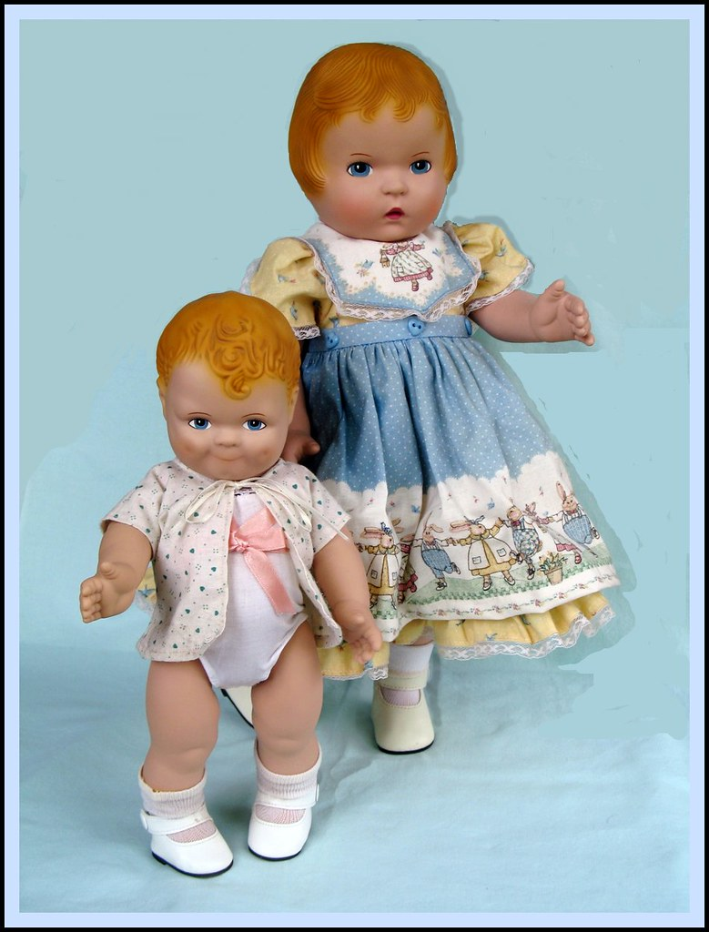
Dolls Lover Fellowship
Rotarians who share a interest in dolls
http://dollloversfellowship.org

Slide 14

Global Fellowship of eRotarians
Rotary Clubs that use technology to advance their activities
RotarianEClubFellowship.org

Slide 15

International Fellowship of Rotarian Editors and Publishers
Bulletin Editors and Webmasters
Club / District / Zone / Fellowship / RAG etc
Share ideas – get answers
Over 18,000 Members
facebook.com/groups/IFREP/

Slide 16
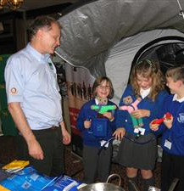
International Fellowship of Rotarian Educators
Rotarians who share a passion for education
Proud sponsor of the FREE Reading program for kids in K-6
https://portal.clubrunner.ca/101279/

Slide 17

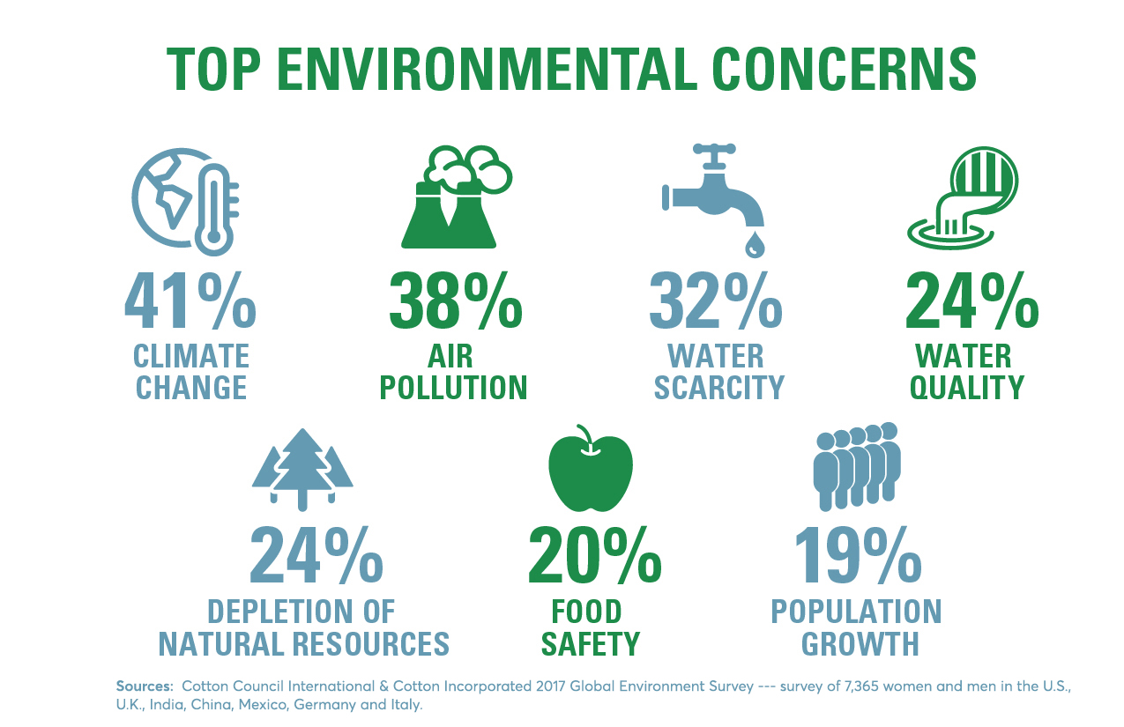
Environment Fellowship of Rotarians
Rotarians, spouses, and Rotaractors who are interested or have a vocation related to the Environment
EnviroRotarians.org

Slide 18


Ethics Fellowship of Rotarians
Rotarians who deeply believe in the principles of ethics and good citizenship, because we represent the essence of the Four Way Test
EthicsFellowship.org

Slide 19
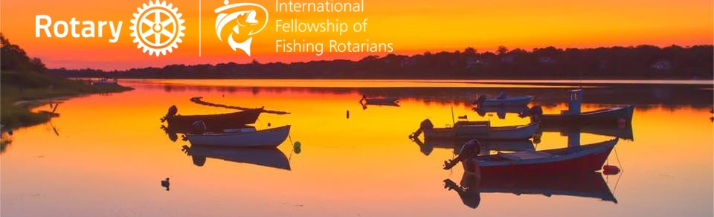
International Fellowship of Fishing Rotarians
Rotarians who enjoy recreational fishing
Over 400 Members
facebook.com/groups/InternationalFellowshipofFishingRotarians/

Slide 20
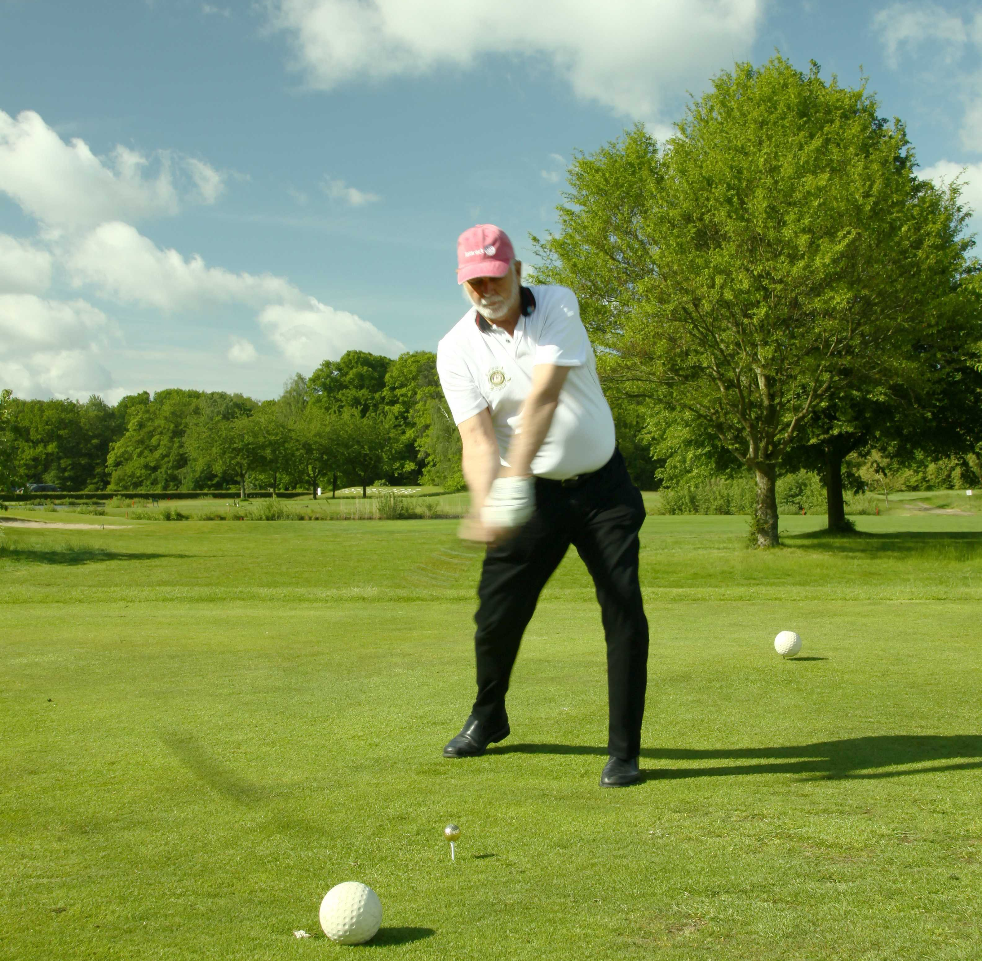
International Golfing Fellowship of Rotarians
Rotary who share the love of Golf
Golfing Rotarians in 61 Countries
IGFE-International.com

Slide 21
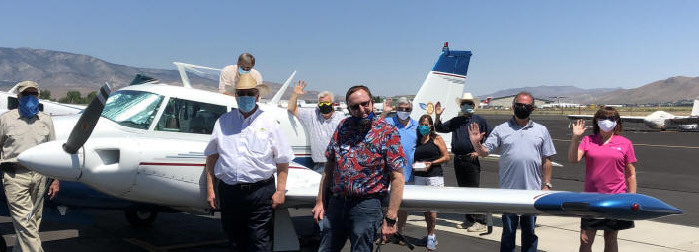
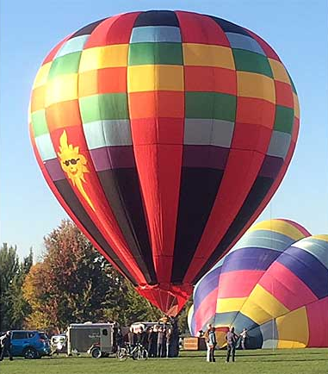
International Fellowship of Flying Rotarians
Rotarian aviation enthusiasts and pilots
IFFRAmericas.org

Slide 22
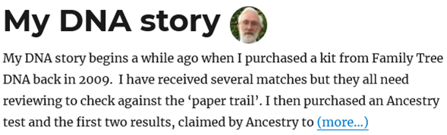

Fellowship of Rotarian Genealogists
Rotarians committed to exploring Genealogy
RotarianGenealogists.org

Slide 23
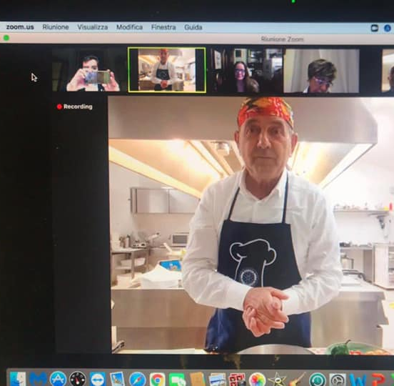
World Fellowship of Rotarian Gourmets
Rotarians, sharing the love for the table, food and wine and above all the banquet
150 Members
facebook.com/The-World-Fellowship-of-Rotarian-Gourmets-100171155351596

Slide 24

Rotary Fellowship Of Graphic Designers
Rotary sharing the passion, Graphic Design
450+ Members
facebook.com/rotarygraphicdesigners/

Slide 25
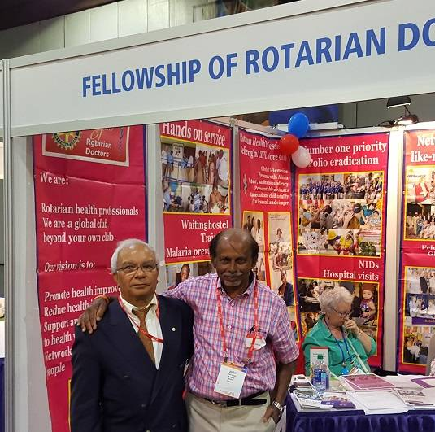
International Rotary Fellowship of Healthcare Professionals
Rotarians in Healthcare – with focus on safe healthcare for everyone and supplying medical equipment to those in need
RotarianDoctors.org

Slide 26

Rotarian Public Health Fellowship
We participate in conferences and other public health initiatives to network, come together to help persons in need, learn and have FUN
polepfr.org
facebook.com/RotarianPublicHealthFellowship

Slide 27
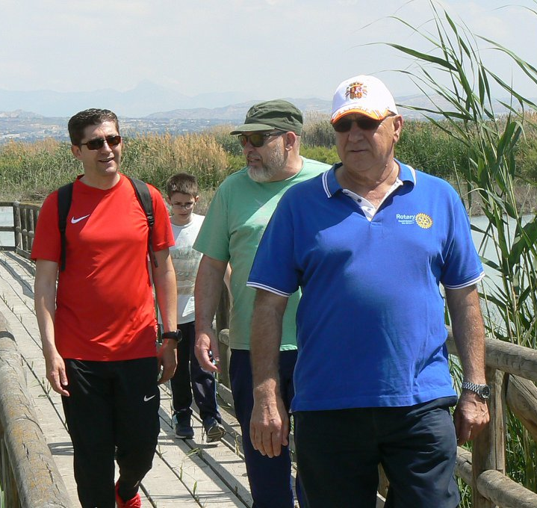
International Hiking Fellowship of Rotarians
Rotarians or Rotaractors with a common hobby of hiking
Over 300 Members
facebook.com/internationalhikingfellowshipofrotarians/

Slide 28

Honorary Consuls' Fellowship of Rotarians
Rotarians or spouses who are or have been Honorary Consuls or Diplomats
25 Members
facebook.com/groups/224273404669925

Slide 29

Rotarians On The Internet
Rotarians who apply modern information technology to enhance Rotary service, fellowship and knowledge
ROTI.org

Slide 30

Italian Culture Worldwide Rotarian Fellowship
Rotarians interested in Italian culture and living abroad, and Italian
facebook.com/ICWRF-Italian-Culture-Worldwide-Rotarian-Fellowship-Londons-Team-1690366404544974/

Slide 31
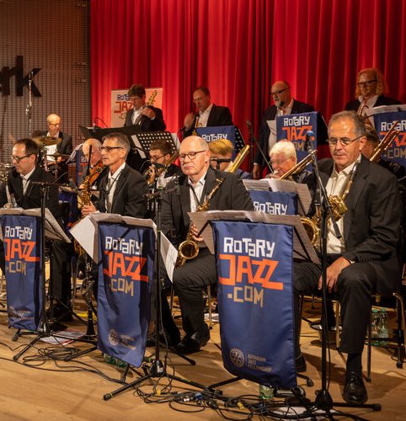
Rotarian Jazz Fellowship
Jazz-loving Rotarians and musicians from all over the world
RotaryJazz.com

Slide 32
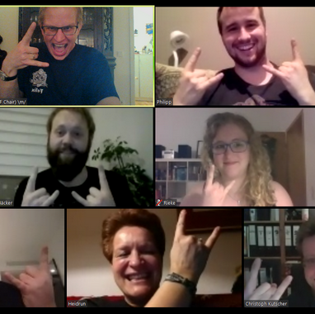
Rotarian Metalhead Fellowship
Rotarians who love metal music
Fellowship supports metal music related service projects within the Family of Rotary
MetalHeadFellowship.org

Slide 33
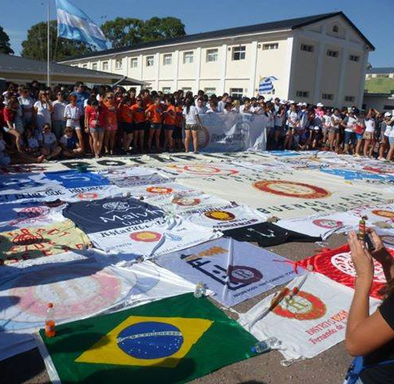
Rotarians for the Advancement of Latin Culture
Over 1,000 Members
facebook.com/RotariosLatinos/

Slide 34
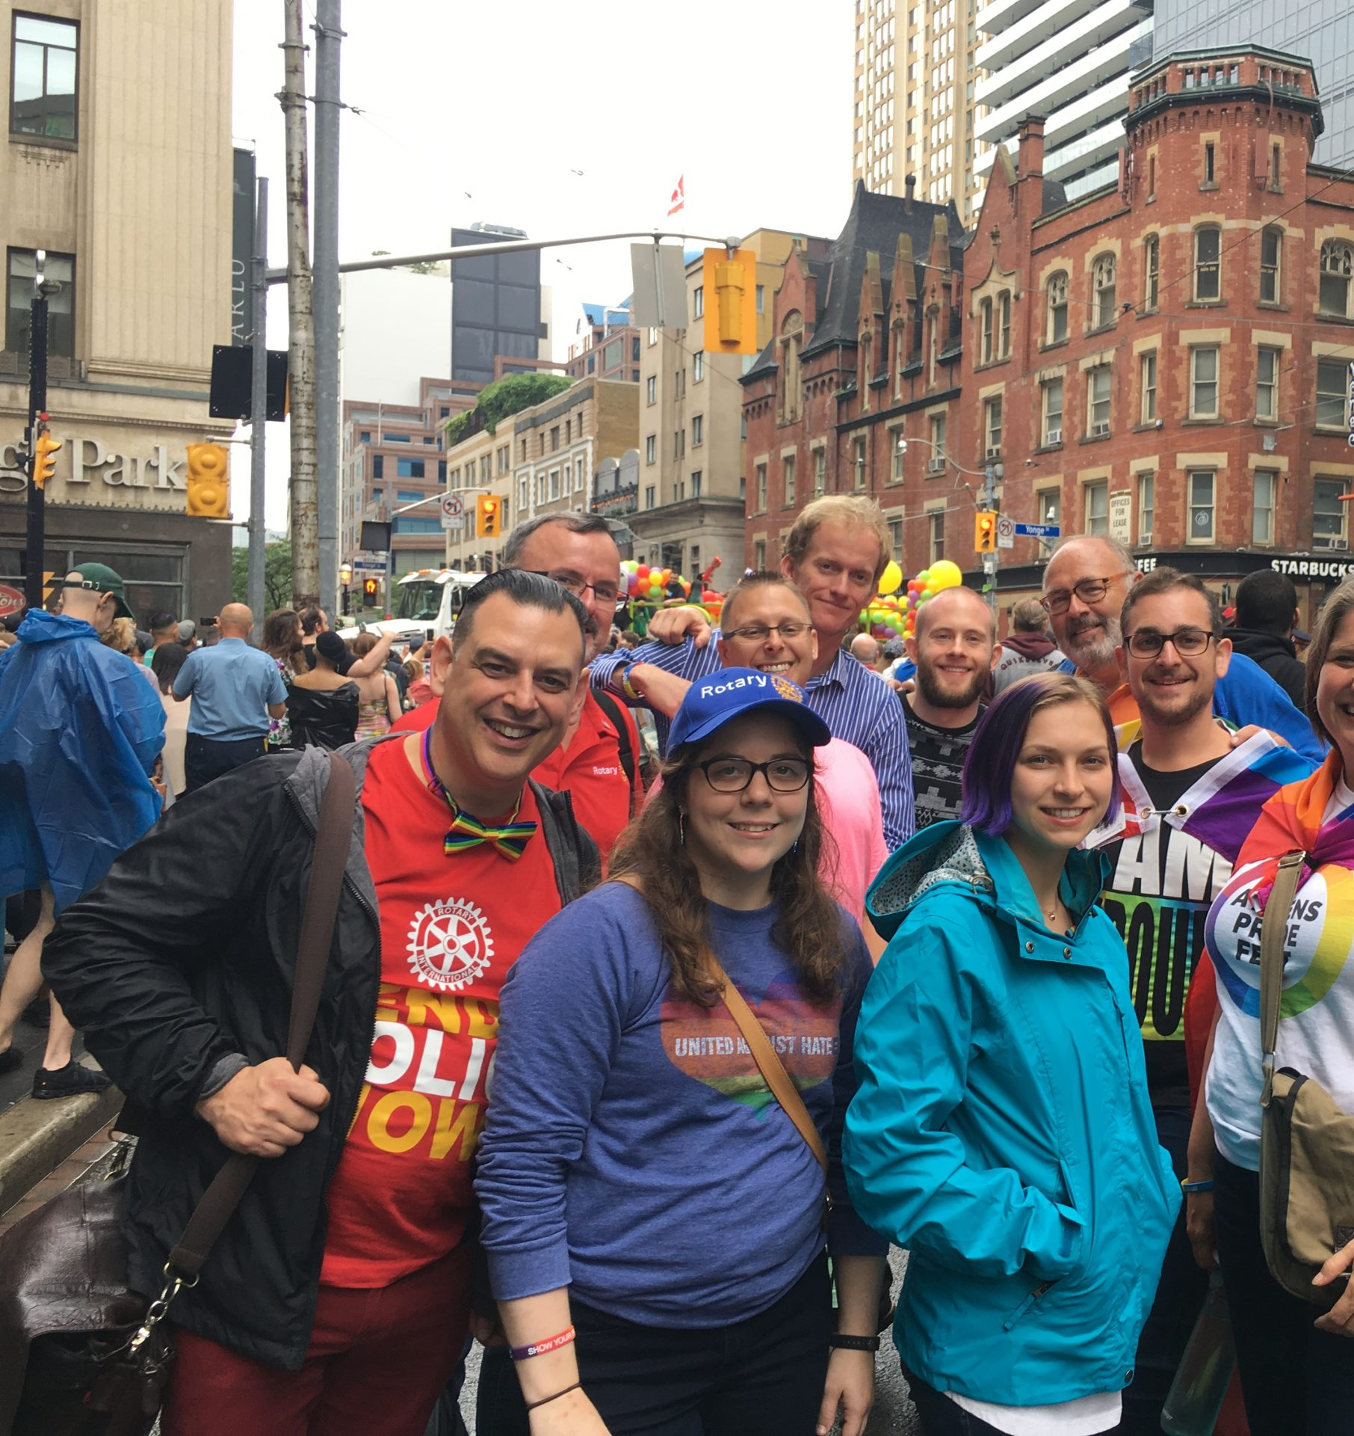
LGBT Rotarians and Friends Fellowship
Rotary Family works to build an organization that is welcoming to members of the LGBT+ community
Over 200 Members
RotaryLGBT.org

Slide 35
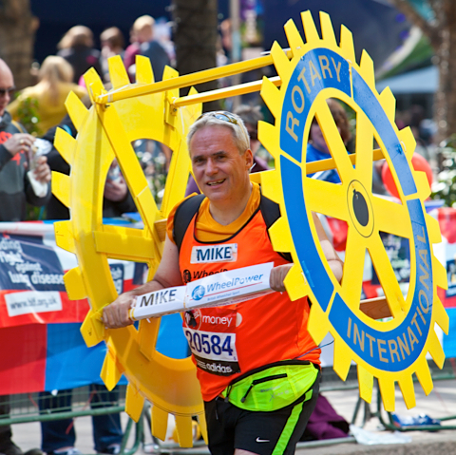
International Marathon Fellowship of Rotarians
Rotarians dedicated to long distance running and endurance sports
Members have come together once a year since 2005 to run in a nominated marathon.
RotarianRun.org

Slide 36
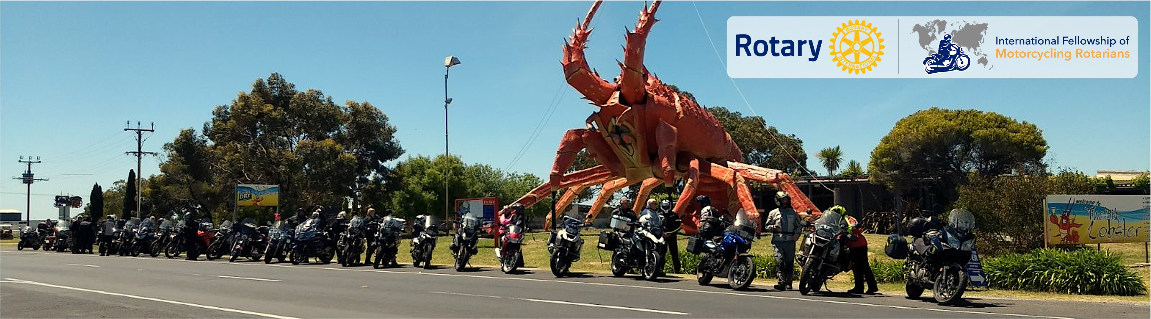
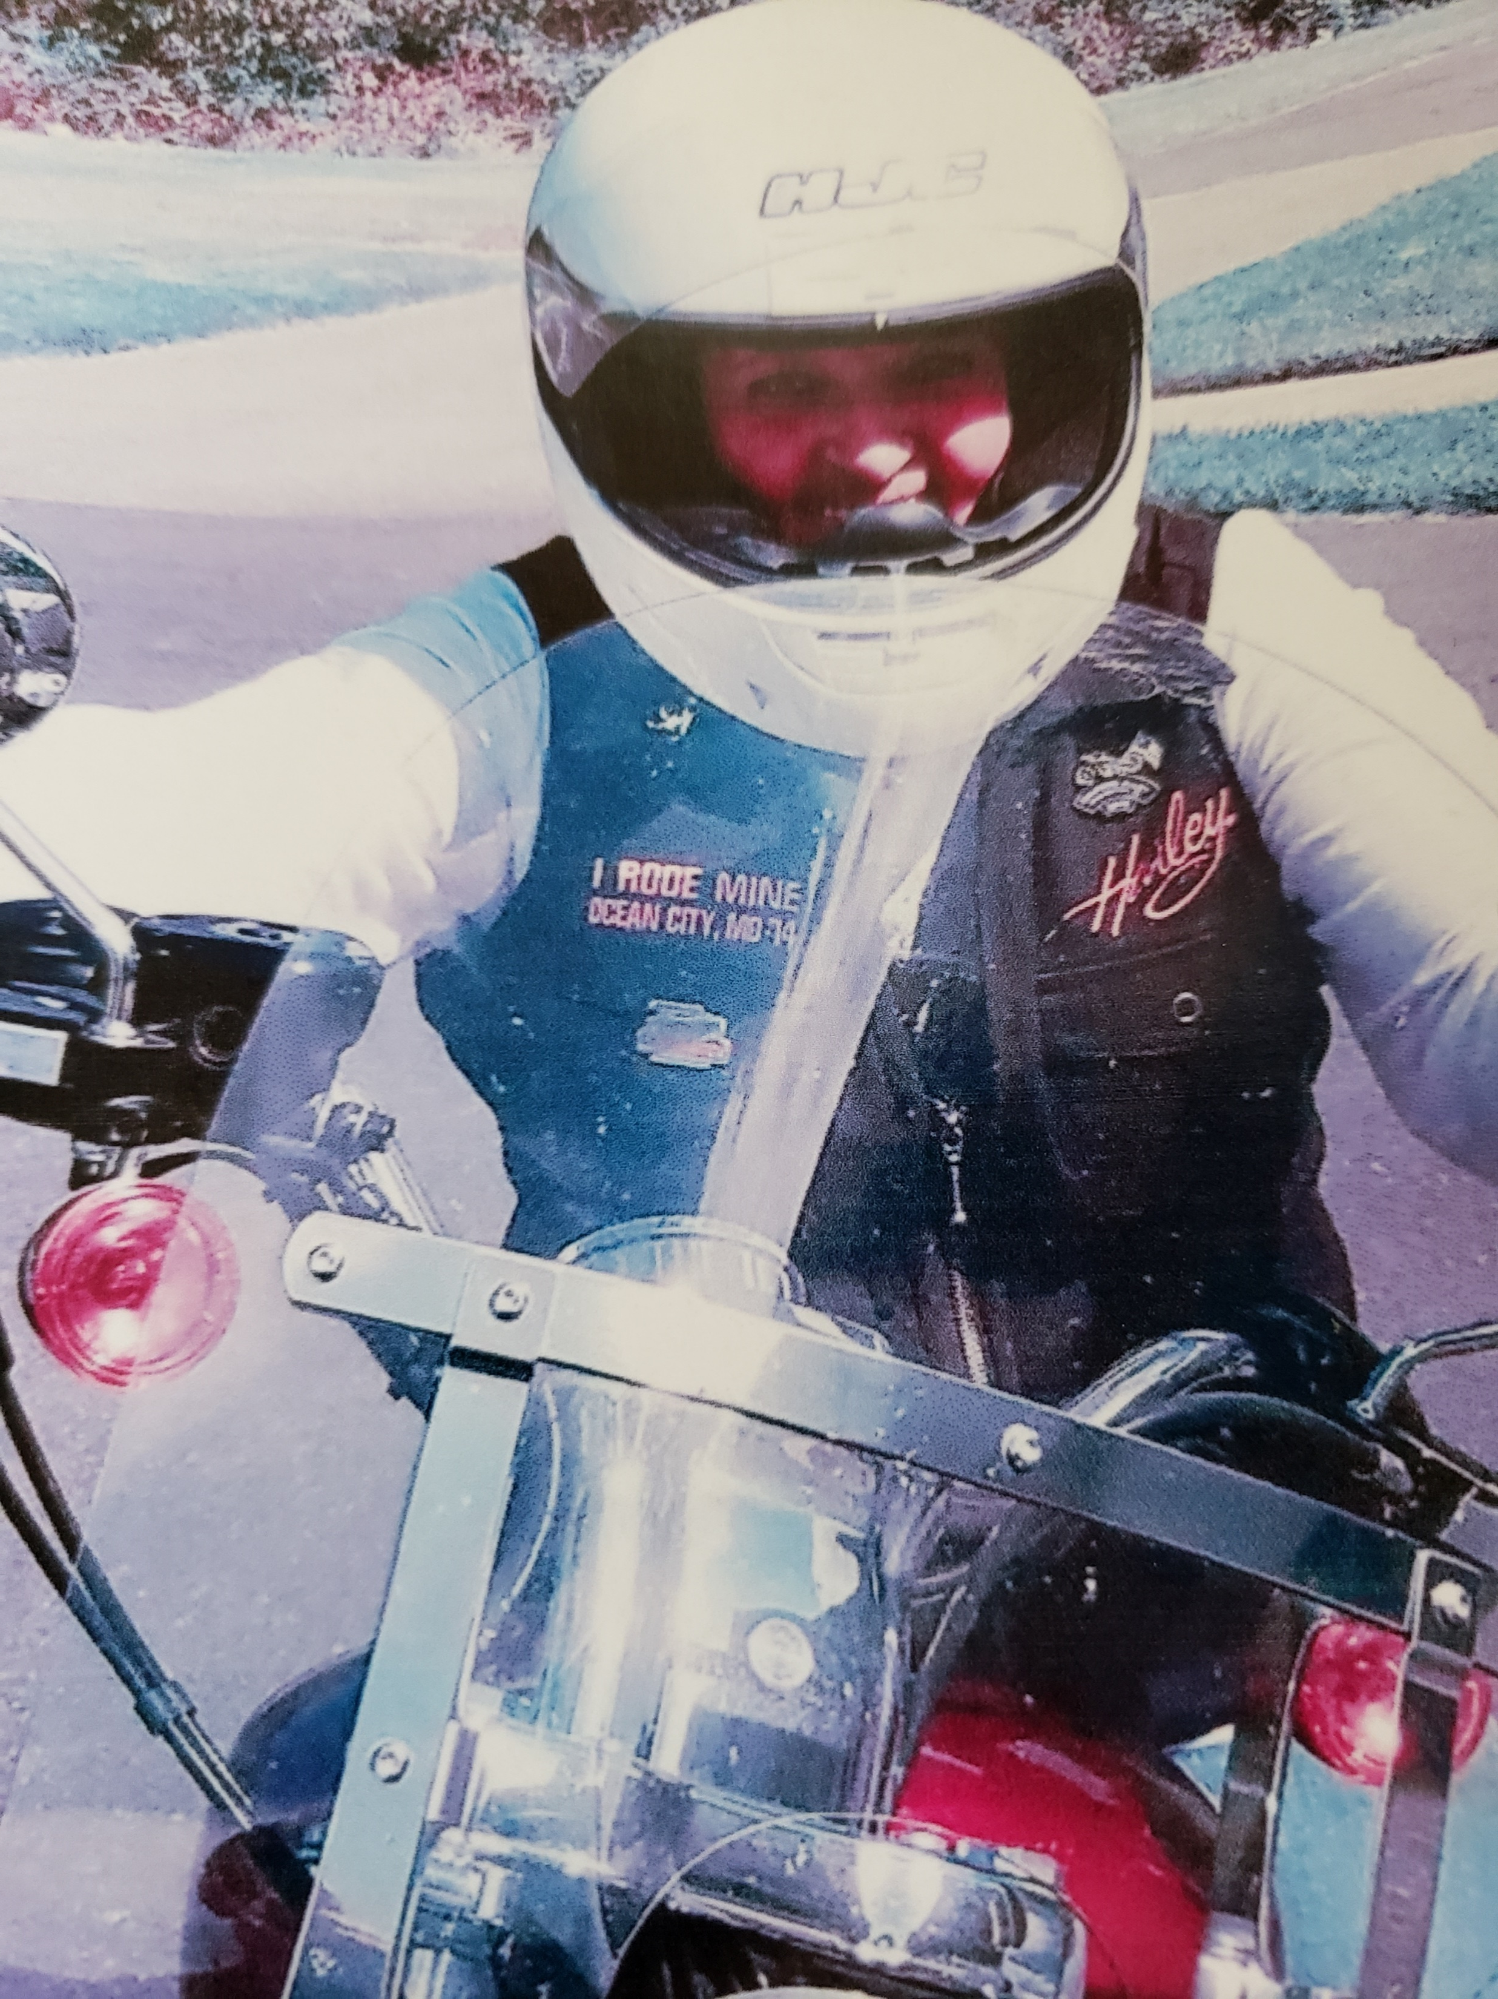
International Fellowship of Motorcycling Rotarians
Rotary Club members who enjoy and share the sport of motorcycling, travel and community service across boundaries and borders
IFMR.org/chapter/North-America.html
District Membership Chair
Pat Campbell-White

Slide 37
International Fellowship of Rotarian Musicians
Rotarians from professional musicians to those who can play a recording on their phone or computer
This group organize musical activities for performances at all levels of Rotary functions, and to support school music programs.
Over 700 Members
IFRM.org

Slide 38
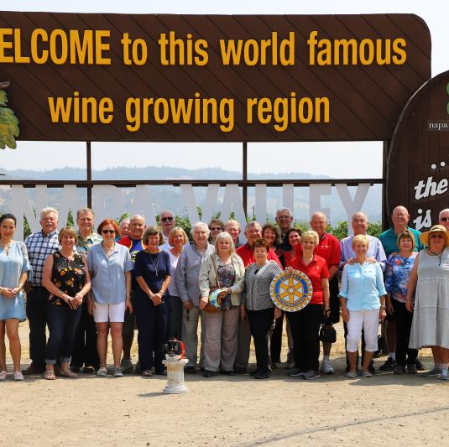
Fellowship of Rotarian PDGs
Rotarians who have served as District Governors
Support important Rotary activities, such as PolioPlus, TRF, international service projects, and membership growth
Over 450 Members
PDGsFellowship.org

Slide 39

Rotary Peace Fellowship
Alumni Association
Rotary Peace Fellow alumni to better facilitate collaboration with Rotary to expand the promotion of peace
100’s of Members
facebook.com/rpfaa.org/

Slide 40
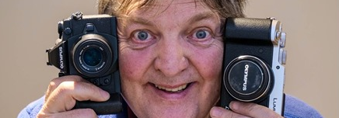
International Fellowship of Rotarian Photographers
Rotarian's & Rotaractor's, who practice Photography in Professional, advanced, amateur, hobby or in beginner levels
Over 800 Members
facebook.com/groups/IFRP1/

Slide 41
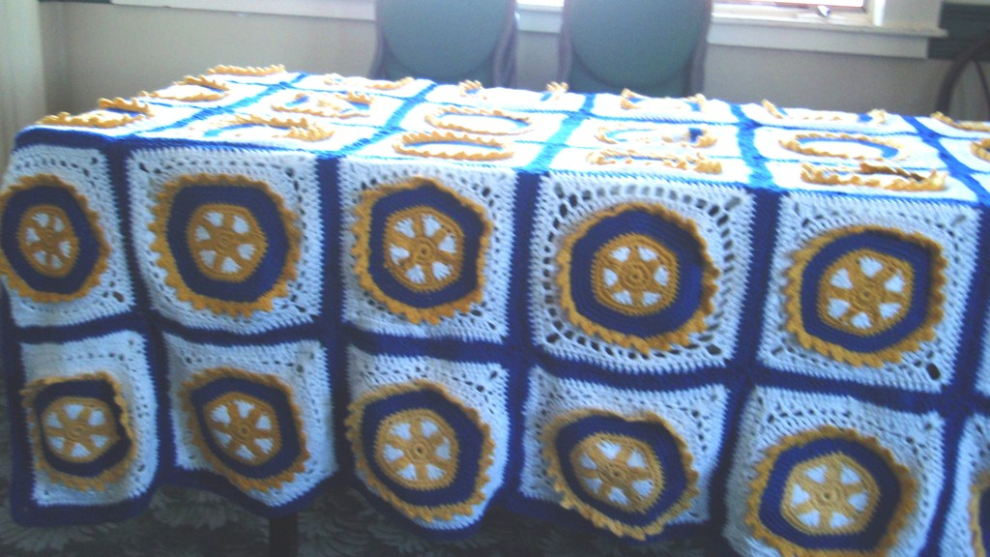
Rotarian Fellowship of Quilters and Fiber Artists
RotariansQuilt.com

Slide 42
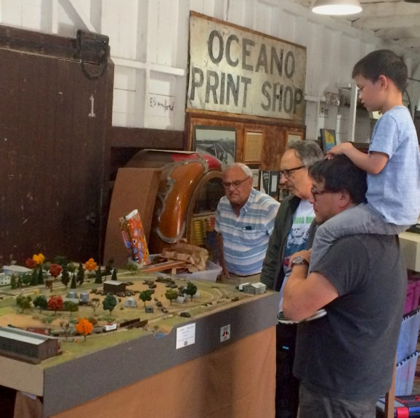
International Fellowship of Railroading Rotarians
Rotarians who have an interest in railroading
IFRR.info

Slide 43
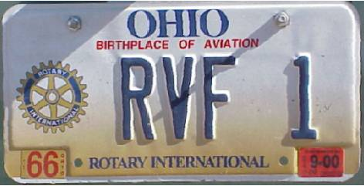
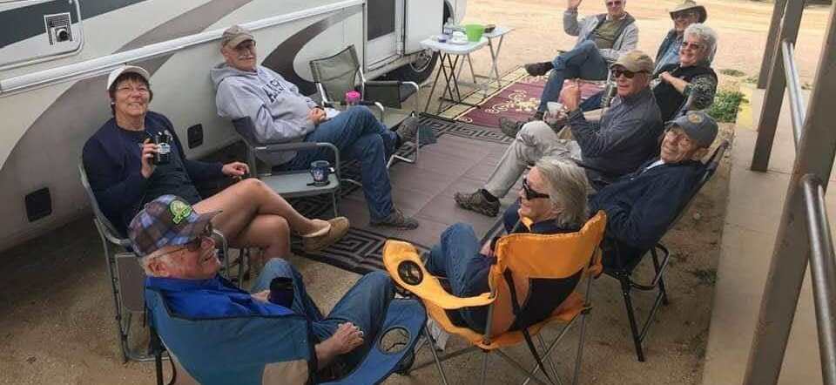
Recreational Vehicle Fellowship of Rotarians
Rotarians who have a love for camping and rallies in various scenic locations in North America
RVFRNA.org

Slide 44
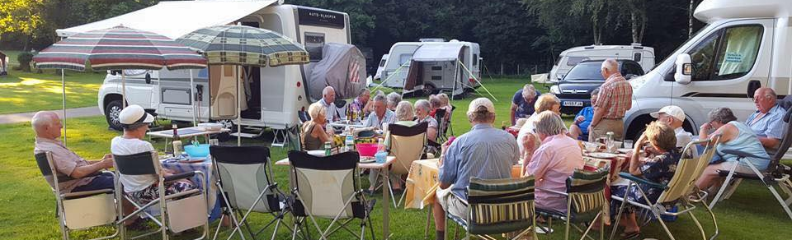
International Caravanning Fellowship of Rotarians
Rotarians with caravans and Motorhomes
ICFRRotariansCaravanning.com

Slide 45
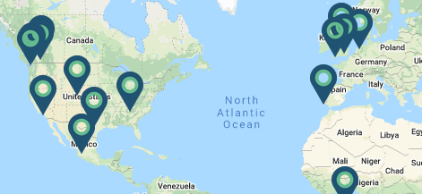
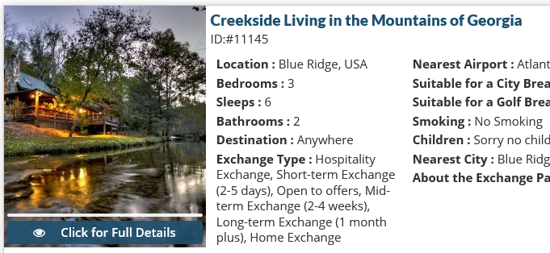
Rotarian Home Exchange Fellowship
Rotarians worldwide swap homes with fellow Rotarians and experience a new ways of living. Stay Free – Travel More
Must be 50+
Over 600 Members
RotarianHomeExchange.com

Slide 46
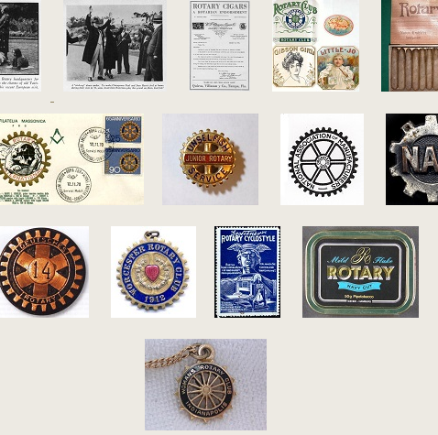
Rotary Global History Fellowship
RGHF offers history training for Rotary leaders to preserves the complete history, values, and philosophy of the Rotary movement
RGHFHome.org

Slide 47
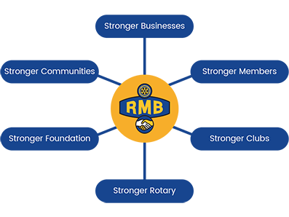
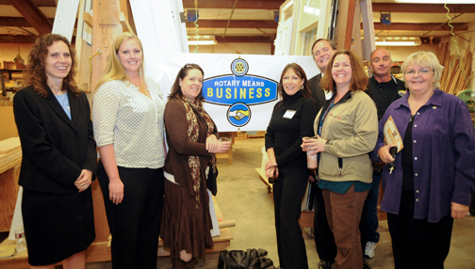
Rotary Means Business Fellowship
Encourages Rotarians to support doing business with other Rotarians, and referrals
Local, Regional & Online Networking opportunities
RotaryMeansBusiness.org

Slide 48

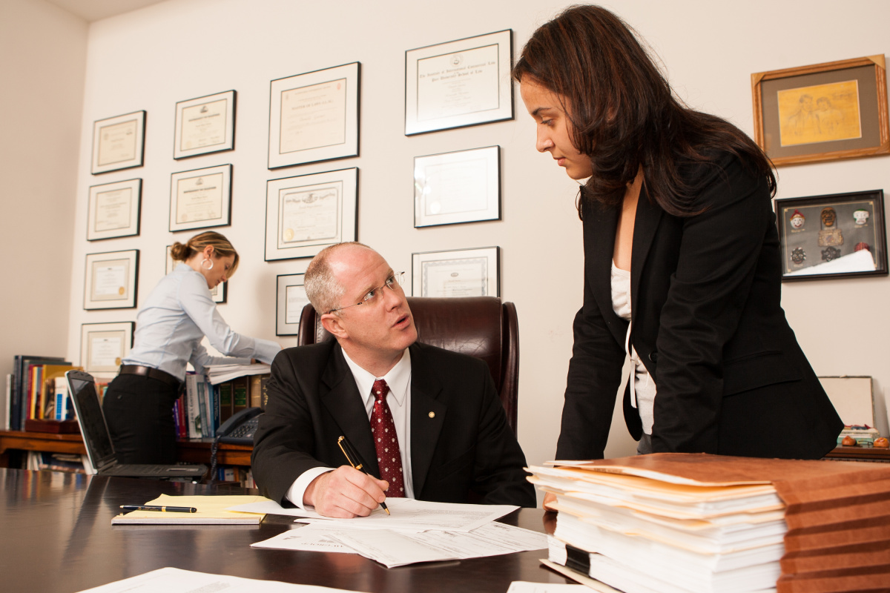
Rotarian Executive Managers Fellowship
Executive Managers Rotarian creating a global, network to attract new Top Executives to Rotary and mentor young Rotarian Entrepreneurs
RotarianExecutiveManagers.com

Slide 49
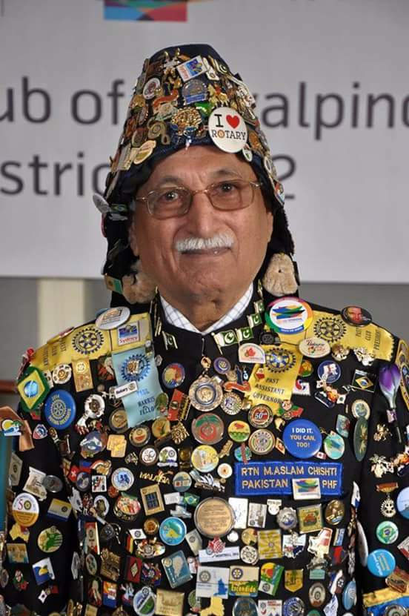
Rotary on Pins Fellowship
RotaryOnPinsFellowship.com

Slide 50

Rotary on Stamps fellowship
RotaryOnStamps.org

Slide 51
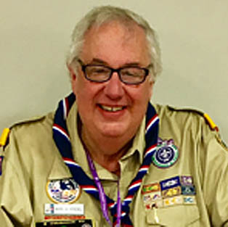
International Fellowship of Scouting Rotarians
Rotarian, in any country, who was formerly or is presently a member of any (girl or boy) Scout Association
Recognition certificates for Rotary Club to present:
BSA: certificates for recipients of Eagle Scout Award and the Sea Scout Quartermaster Award
Girl Scouts USA: for recipients of the Girl Scout Gold Award.
ScoutingRotarians.org

Slide 52
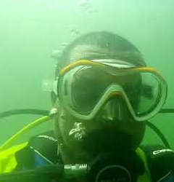
International Fellowship of Rotarian Scuba Divers
Rotarians who enjoy scuba diving
Typically do two dive trips per year
Almost 300 Members
IFRSD.org
facebook.com/groups/150959392719

Slide 53
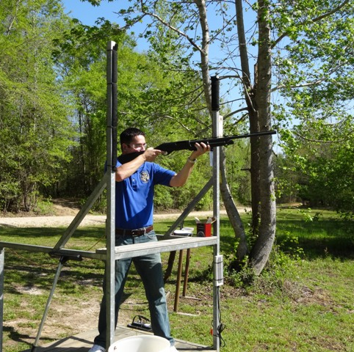
International Fellowship of Shooting Sport Rotarians
Rotarians who promote knowledge on safe handling and proper care of firearms
ShootingSportRotarians.org

Slide 54
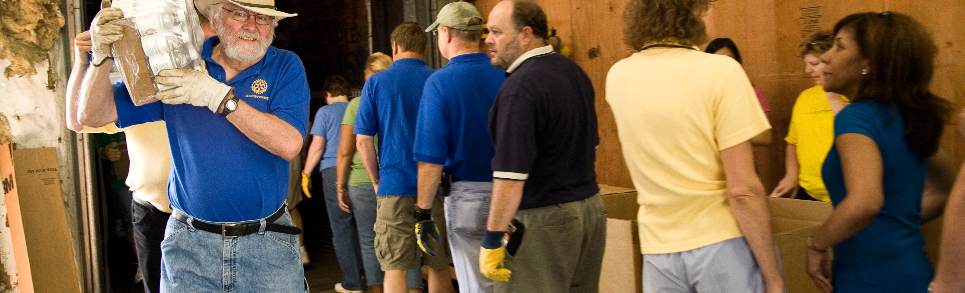
Rotarian Singles Fellowship International
Single Rotarian for Service and Fellowship
Over 300 Members
RotarianSingles.org

Slide 55
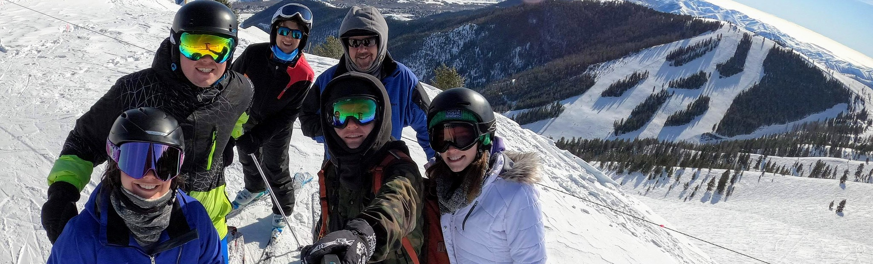
International Skiing Fellowship of Rotarians
Rotarians travel to a different ski resort in North America for a week of skiing, fun, and friendship
Raise funds for adaptive ski programs
ISFRSki.org

Slide 56
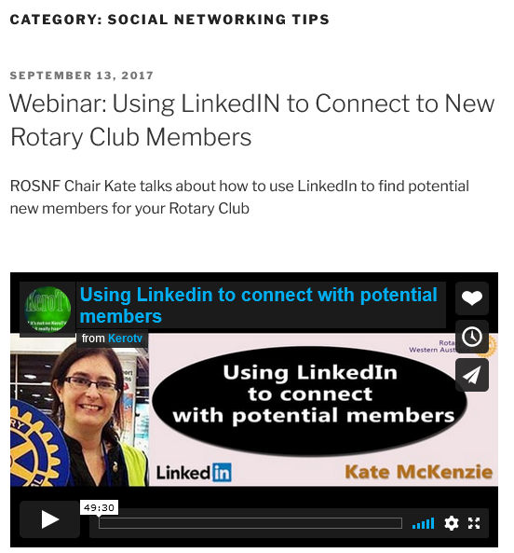
Rotarians on Social Networks Fellowship
Rotarians dedicated to promoting social media as an opportunity to enhance Rotary
RoSNF.org

Slide 57
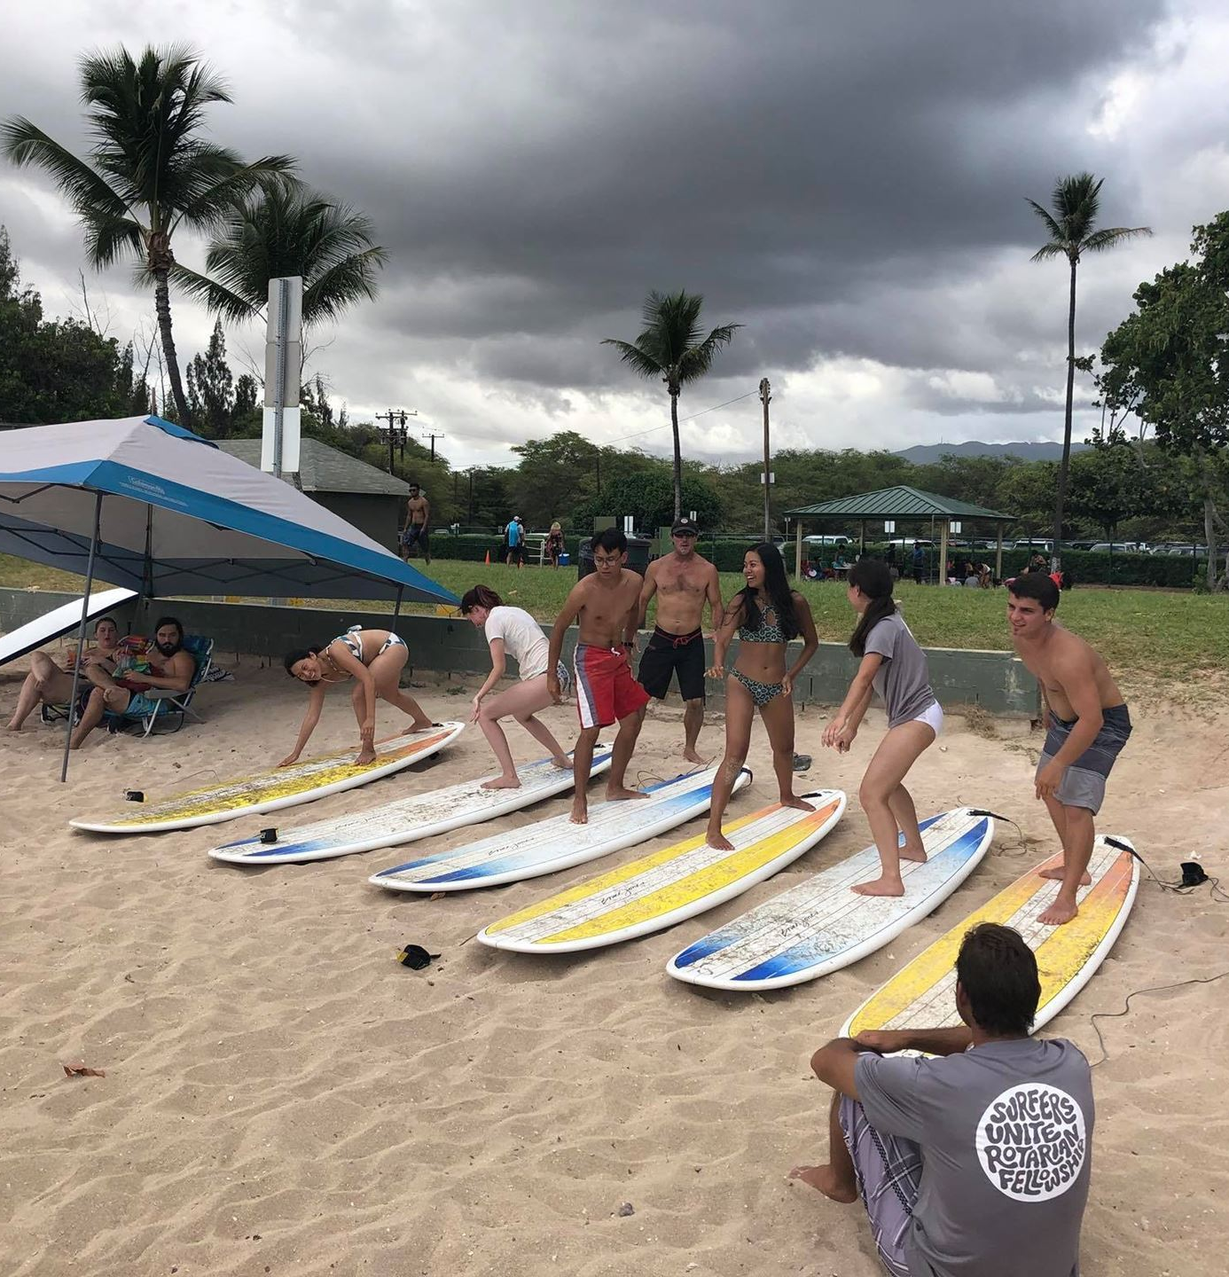
Surfers Unite
Rotarian Fellowship
Rotarians who are beach enthusiast, bodyboarder, bodysurfer, kite surfer, stand up paddle boarder (SUP), surfer or wind surfer
Shoreline, beach clean ups projects
Over 900 Members
SurfersUnite.org

Slide 58

International Fellowship of Wellness and Fitness Rotarians
Over 100 Members
facebook.com/groups/134928356987548

Slide 59

International Yachting Fellowship of Rotarians
3685 members
126 active Rotary yachting fleets in 44 countries
IYFR.net

Slide 60

Whiskey Drinking Rotarians And Members
Learn more about all the whiskies of the world including bourbon, scotch, rye, sour mash and moonshine
A portion of the net proceeds of our Fellowship will be given, to a Rotary-sanctioned campaign focused on safe drinking water.
WhiskeyDRAM.org

Slide 61

Rotary Fellowship of Gin
Calling Rotary Gin lovers!
Rotarians who share a love of Gin. We supports clean water, sanitation, and hygiene projects worldwide.
GinFellowship.org

Slide 62

Wine Appreciation Fellowship
Rotarians who share a love of wine, wine and food pairings and any other topics related to the appreciation of wine
RotaryWine.net

Slide 63

Beers Rotarians Enjoy Worldwide
Rotarians who share a love of beer. We support projects to bring clean water to those in thirst
RotaryBREW.org

Slide 64

Fellowships engage the family of Rotary through shared interests
For general program information, visit www.rotary.org/fellowships.
Here you’ll find the following:
Rotary Fellowships Flier
Rotary Fellowships Application Form

Slide 65


Slide 66


Slide 67
QUESTIONS

